Slide 1
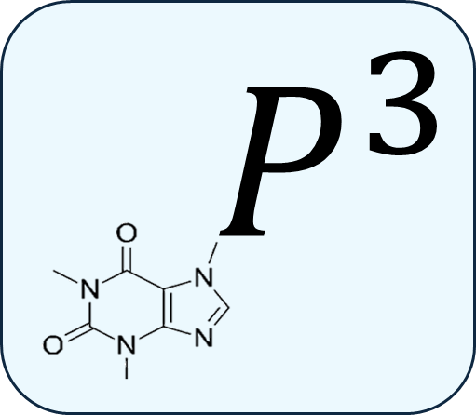
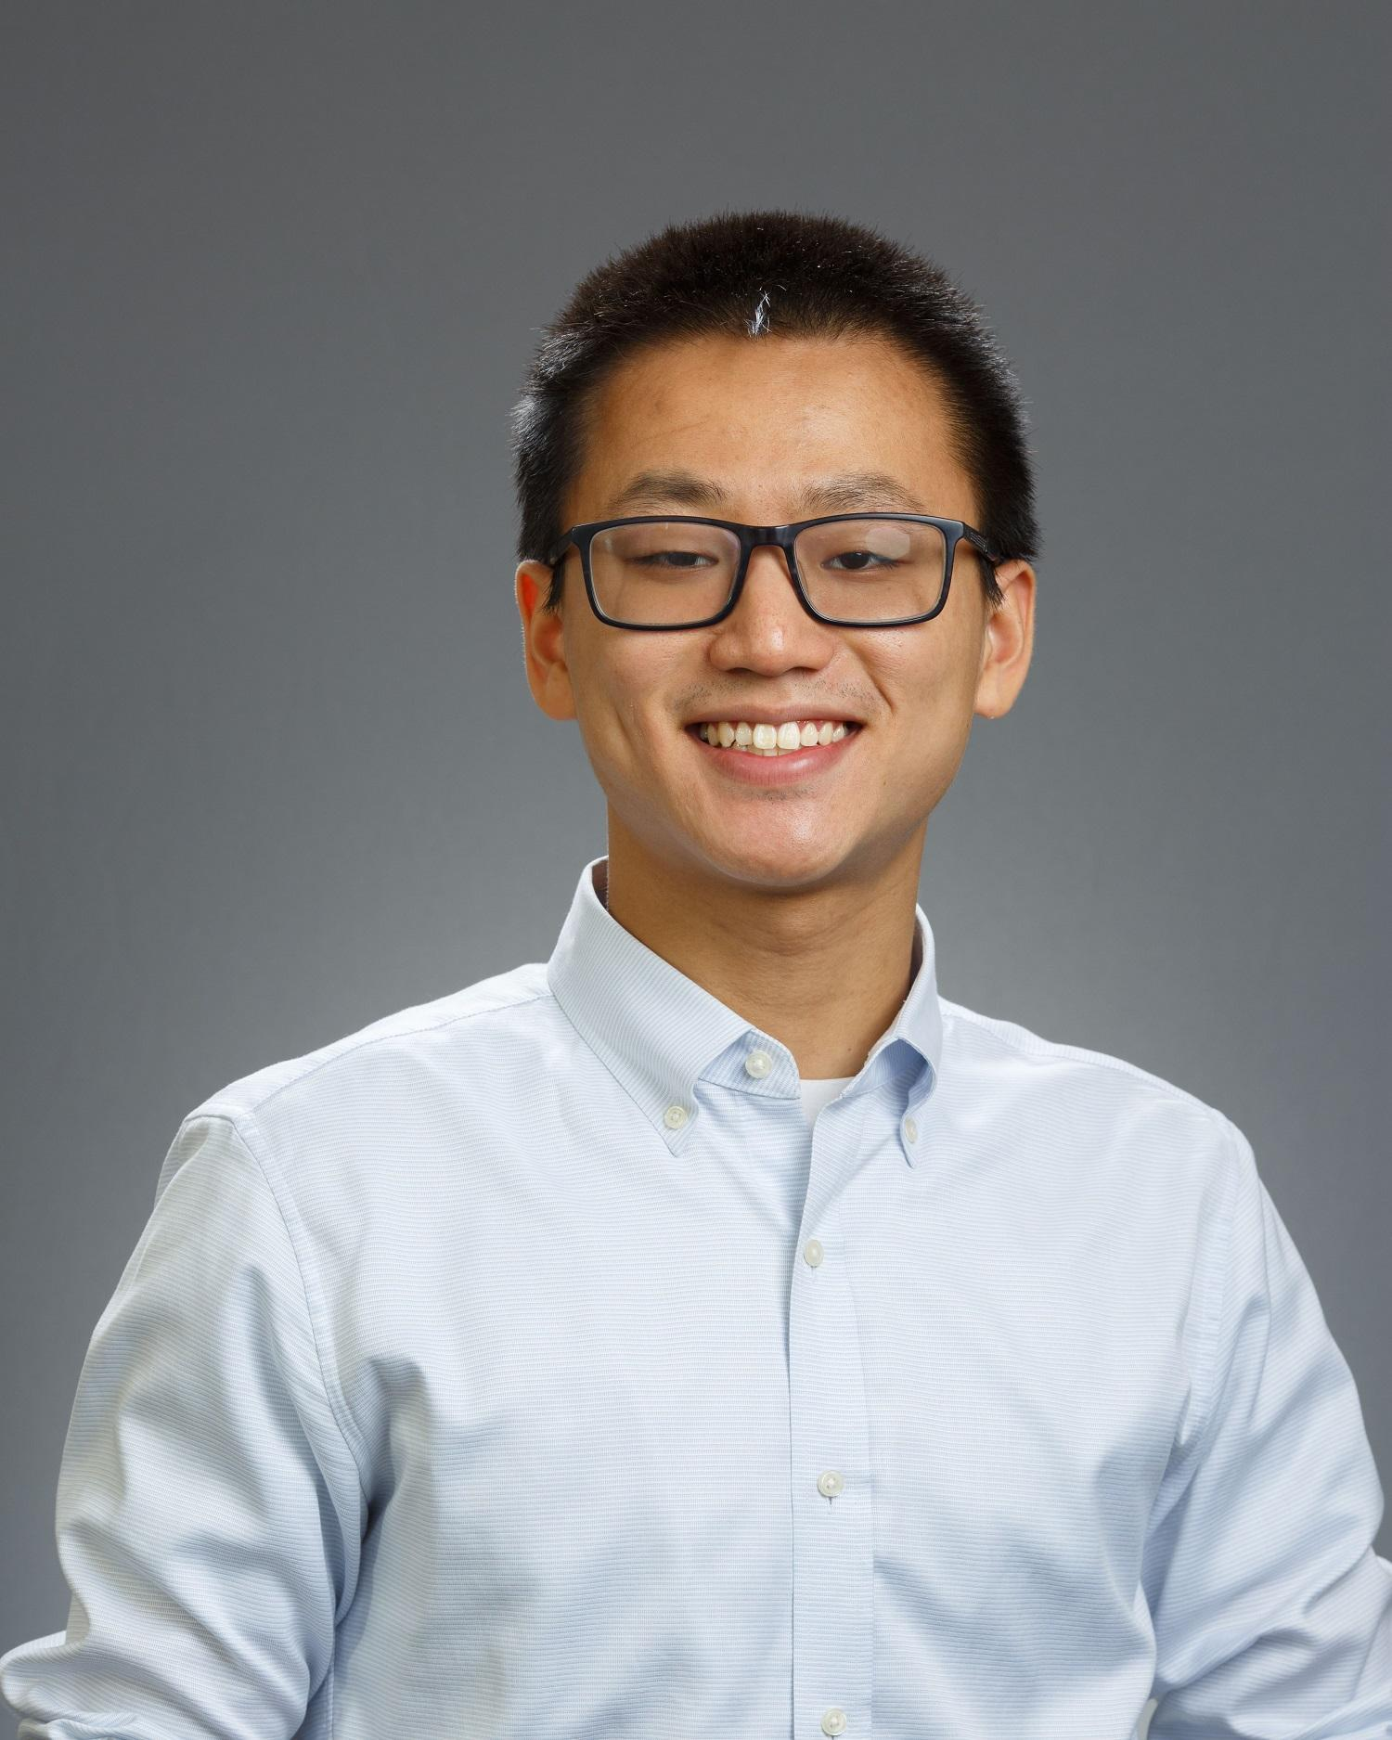

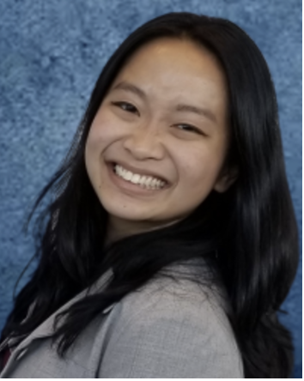


Personalized Proteomics for Cancer Drug Discovery and Treatment
Aiswarya Menon,
Alagu Subramanian,
Ethan Wong,
Jessica Tang,
Theodore Nelson
Notes:
Slide 1 - Hello everyone, today we will presenting our AI model to you all, called Efficure: an AI model that predicts drug efficacy in cancer.
Firstly, we would like to thank our hosts GetSeenVentures and Cancer Research UK training programme for organising this hackathon, as well as the sponsors for this event.

Slide 2
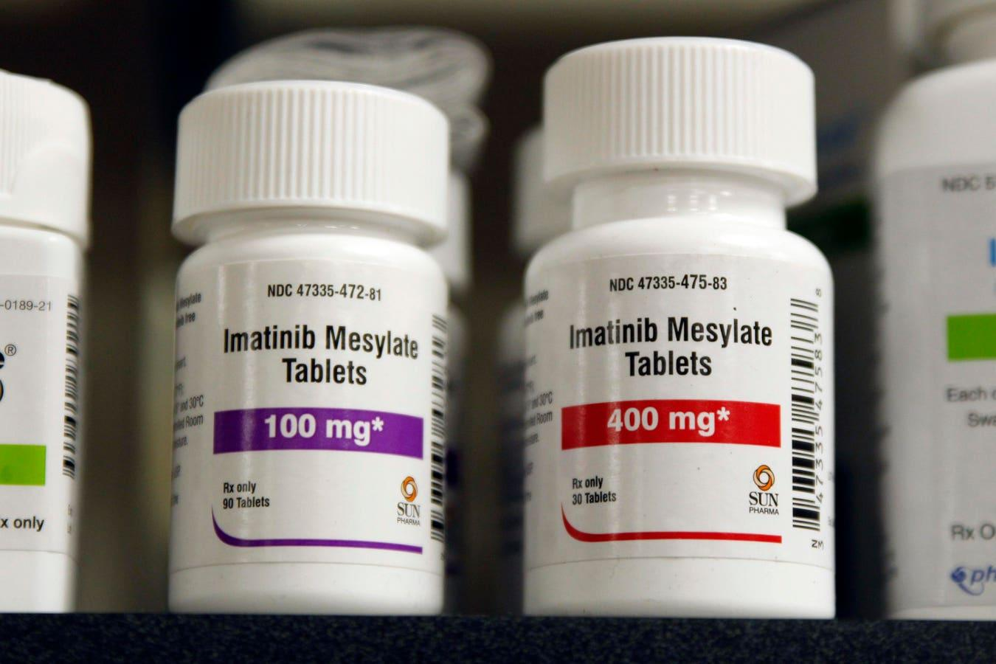
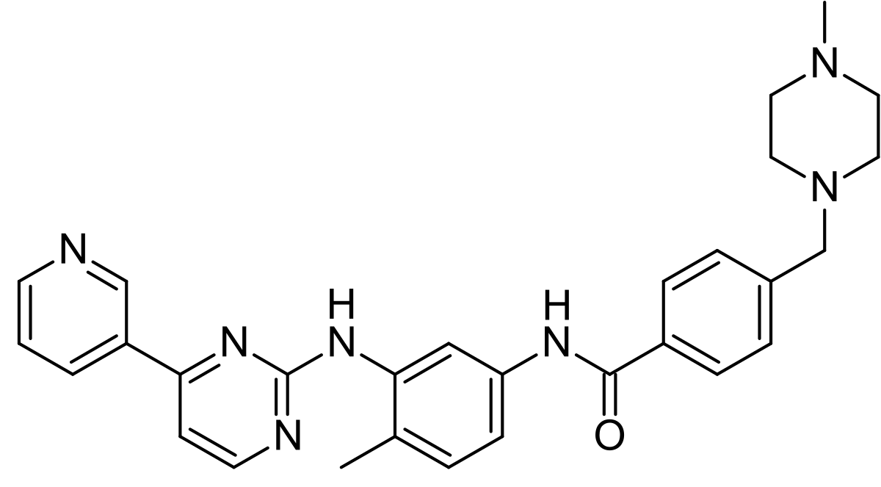
Story of a Single Drug
Orosomucoid (ORM) or alpha-1-acid glycoprotein (α₁AGp, AGP or AAG) is an acute phase protein found in plasma.

Slide 3
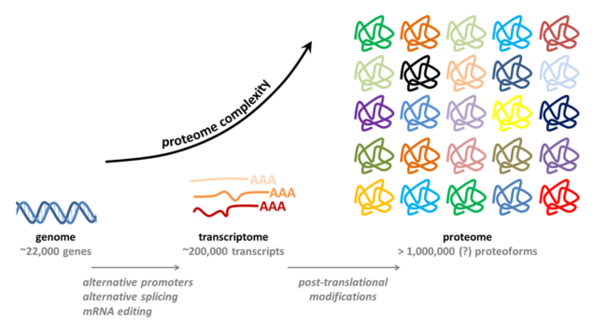
Proteomics Capture Cell State
https://www.proteomicscenter.nl/background-information/

Slide 4
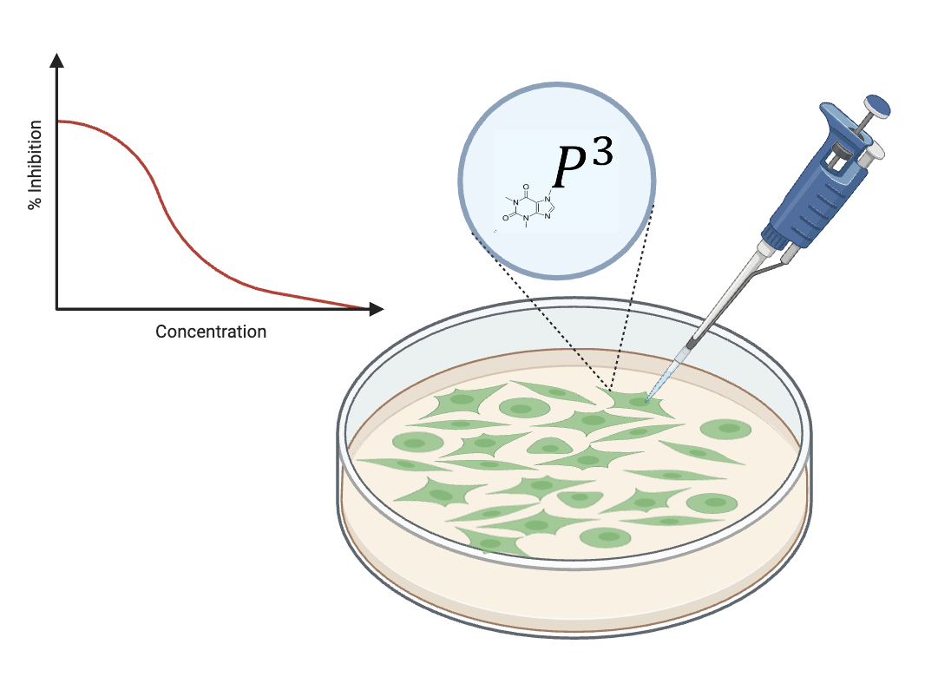
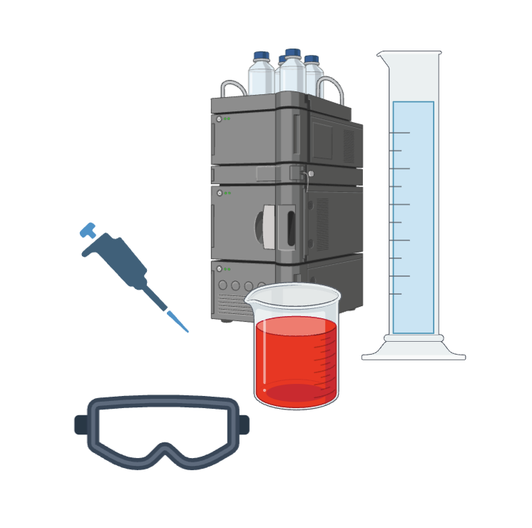
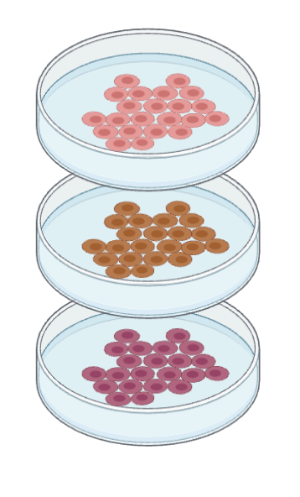
Problem
£
Notes:
1. Trend towards repurposing drugs for different cancers.
2. It is important to understand the drug cytotoxicity in relation to the cell type and even genetic mutation, but IC50 experiments may be time and resource intensive.
3. Different cells or even genetic mutations among cell types may overexpress molecular targets of the drug or
3. Current tools for predicting IC50 does not account for cell type, only compound structure

Slide 5
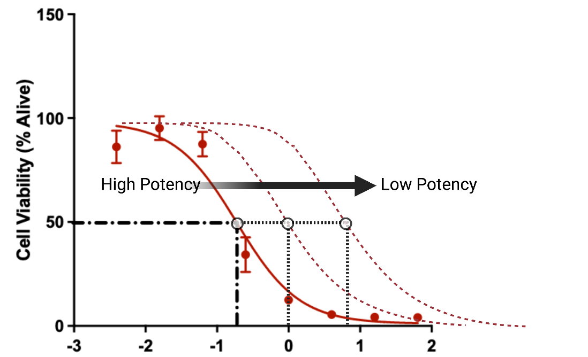
Drug Efficacy: IC50
IC50 is a measure of drug cytotoxicity indicating compound potency
A measurement of the concentration of a drug required to inhibit cell viability by 50%
Log[µM]
Limitations with IC50 testing: not personalised, resource-intensive
 | Drug X
IC50 | 0.1891
Notes:
When administering a drug, it’s important to note the drug efficacy - a measure of how well the drug works. For this, researchers often rely on obtaining the IC50 value: a quantitative measurement of how much of a drug or compound is required to inhibit a biological process by half. Generally, the lower the IC50 value, the more potent a drug is. However, IC50 testing is often time-consuming and requires significant resources.

Slide 6
Features & Targets
General Features:
Drug Name
Cell Line Name
Morgan molecular fingerprint bits for the drug (CHEM_mBit_0 to CHEM_mBit_255)
Pathway enrichment scores (PES) based on the Drug-Gene Network (DG-Net), gene expression data, mutated genes, and copy number (CNV) data.
Example: TARGETnNEIGHBOR_PID_FANCONI_PATHWAY measures the involvement of drug-associated genes in the Fanconi anemia pathway.
Target
IC50 Scores
Over 150 initial Training features to predict IC50 drug potency score…
Expanded to 1030 specific training features for highly personalized treatment insight
Notes:
Based on the referenced paper, here's the explanation of the columns:
General Columns:
drug: The name or identifier of the drug being analyzed for its sensitivity in cancer cell lines.
cell: The identifier of the cancer cell line being studied.
Chemical Structure Data:
CHEM_mBit_0 to CHEM_mBit_255: These columns represent the Morgan molecular fingerprint bits for the drug, which are binary descriptors derived from the chemical structure of the drug. These features encode specific chemical substructures or properties and are used for predicting the drug's behavior.
Pathway Enrichment Scores:
TARGETnNEIGHBOR_*_PATHWAY: These columns contain pathway enrichment scores based on the Drug-Gene Network (DG-Net). They assess how much the drug-associated genes and their neighbors in a protein-protein interaction network are enriched in a specific pathway (e.g., "FANCONI_PATHWAY"). The pathways are curated sets of genes known to be involved in biological processes related to cancer.
Example: TARGETnNEIGHBOR_PID_FANCONI_PATHWAY measures the involvement of drug-associated genes in the Fanconi anemia pathway.
EXP_*_PATHWAY: These columns represent pathway enrichment scores for gene expression data in the cancer cell line. Calculated using single-sample Gene Set Enrichment Analysis (ssGSEA), these scores indicate the activity level of specific pathways in the cell line based on expressed genes.
MUT_*_PATHWAY: These columns show pathway enrichment scores based on mutated genes in the cancer cell line. They reflect how mutations in the cell's genes contribute to pathway activity.
CNV_*_PATHWAY: These columns represent pathway enrichment scores for copy number variation (CNV) data. CNVs include amplifications or deletions of genes in the cell line, affecting pathway activity.
Response Column:
resp: The response of the cancer cell line to the drug, typically represented by the log-transformed IC50 value. A lower IC50 value indicates higher sensitivity to the drug.
Purpose and Usage of Columns:
The chemical fingerprints (CHEM_mBit) capture the drug's intrinsic properties, while the pathway enrichment scores link the drug’s molecular targets and the cancer cell line’s genomic alterations to known biological pathways. Together, these features are input into a deep neural network to predict drug sensitivity and provide interpretable insights based on pathway involvement.
Let me know if you need further clarification or examples for specific pathways or data types!

Slide 7


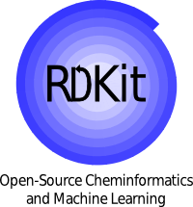


Our Model Architecture:
Bidirectional LSTM
Output
Input Size: 128
Hidden Size: 64
Number of Layers: 2
Input Layer
> 1030 Features
Feature Extractor
1-D IC50 Prediction
First Linear Layer (1030 -> 256 dim)
Dropout
(.2)
Second Linear Layer (256 -> 128 dim)
Dropout
(.2)
Fully Connected Neural Net
RELU
RELU
First Linear Layer (128 -> 32 dim)
Dropout
(.2)
Second Linear Layer
(32 -> 1 dim)
Dropout
(.2)
RELU
RELU

Slide 8
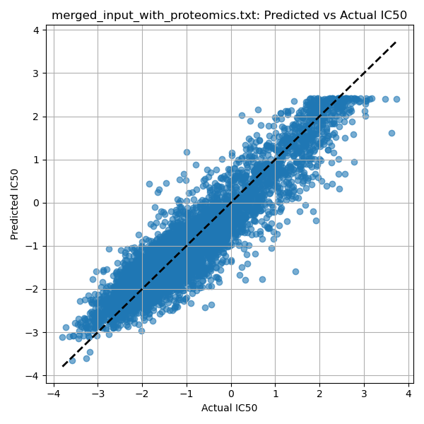




Our Solution
Utilize a personalised proteomics approach to predict drug potency based on cancer cell line models
Build a pathway-based ML architecture trained on 1,030 inputs of patient specific data and IC50 target values across 200 drugs in 300 different cancer cell lines
Enable novel drug-lead input and predict their IC50 response across genotypic and phenotypic parameters of interest based on the trained model.
85% accuracy (right) + 75% accuracy plasma proteomic response linear classifier (not shown)
Notes:
Our solution: efficure, allows for prediction of drug efficacy and cytotoxicity in cancer cell lines, and it’s a way of doing personalised screening without doing personalised drug testing on the patients. The process involves data collection from an extensive dataset of 200 cell lines and 2000 drugs. Next, we trained the model using (insert model training types used) on IC50 values across different cell lines. Hence, but inputting novel drugs the model accurately predicts their IC50 values with 85% accuracy.

Slide 9



Benefits & Applications
Immediate predictions with stream-lined physical testing parameters
Streamlines early-phase drug development and accelerate drug discovery pipeline
Reduces costs associated with lab tests and experimental setups.
Can handle a large number of compounds and cell lines simultaneously.
A personalised approach, tailoring drug treatments to specific genetic and or phenotypic profiles based on IC50 predictions

Slide 10
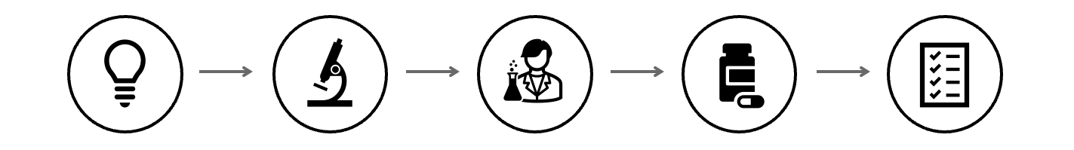
Future Potential
Real-time monitoring of patients with plasma proteomics and physiological prediction of drug treatment response
Potential for widespread adoption in both research and clinical settings
Opportunities for expanding the model with more drugs, cell lines, and personalized patient data.

Slide 11

Acknowledgements + GitHub Repo
This repository contains the work produced during the first-ever AI x Cancer Bio Hackathon, held at Newnham College. We would like to thank the sponsors, mentors, and organizers who made this event possible:
Tanmay Gupta from GetSeen Ventures
Keynote speaker Prof Raj Jena, Dept of Oncology
Mentors, including Jonathan Hsu from Valence Lab and Dr Maxime Allard from Helical
We are grateful for the support of Newnham College, which hosted this exciting event.
https://github.com/Theo-Nelson/cruk-hackathon

